Slide 1
Open-set recognition A good closed-set classifier is all you need
ICLR 2022
Jeonbuk National University, Korea
Multimedia Lab Under Prof. Park and Prof. Yoon
Mingle Xu
2022

Slide 2
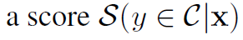
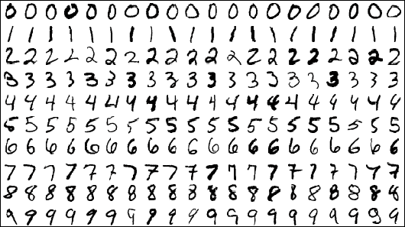
Definition of OSR
Class in training and testing
Requirements
Check open class
If not open class, predict the close class
Output of OSR
Close class
Open class

Slide 3

Similar terminologies
Novelty detection, binary classification, if open class or close class
Out-of-distribution.
Training
Testing
2018 ICLR enhancing_the_reliability_of_out_of_distribution_image_detection_in_neural_networks

Slide 4
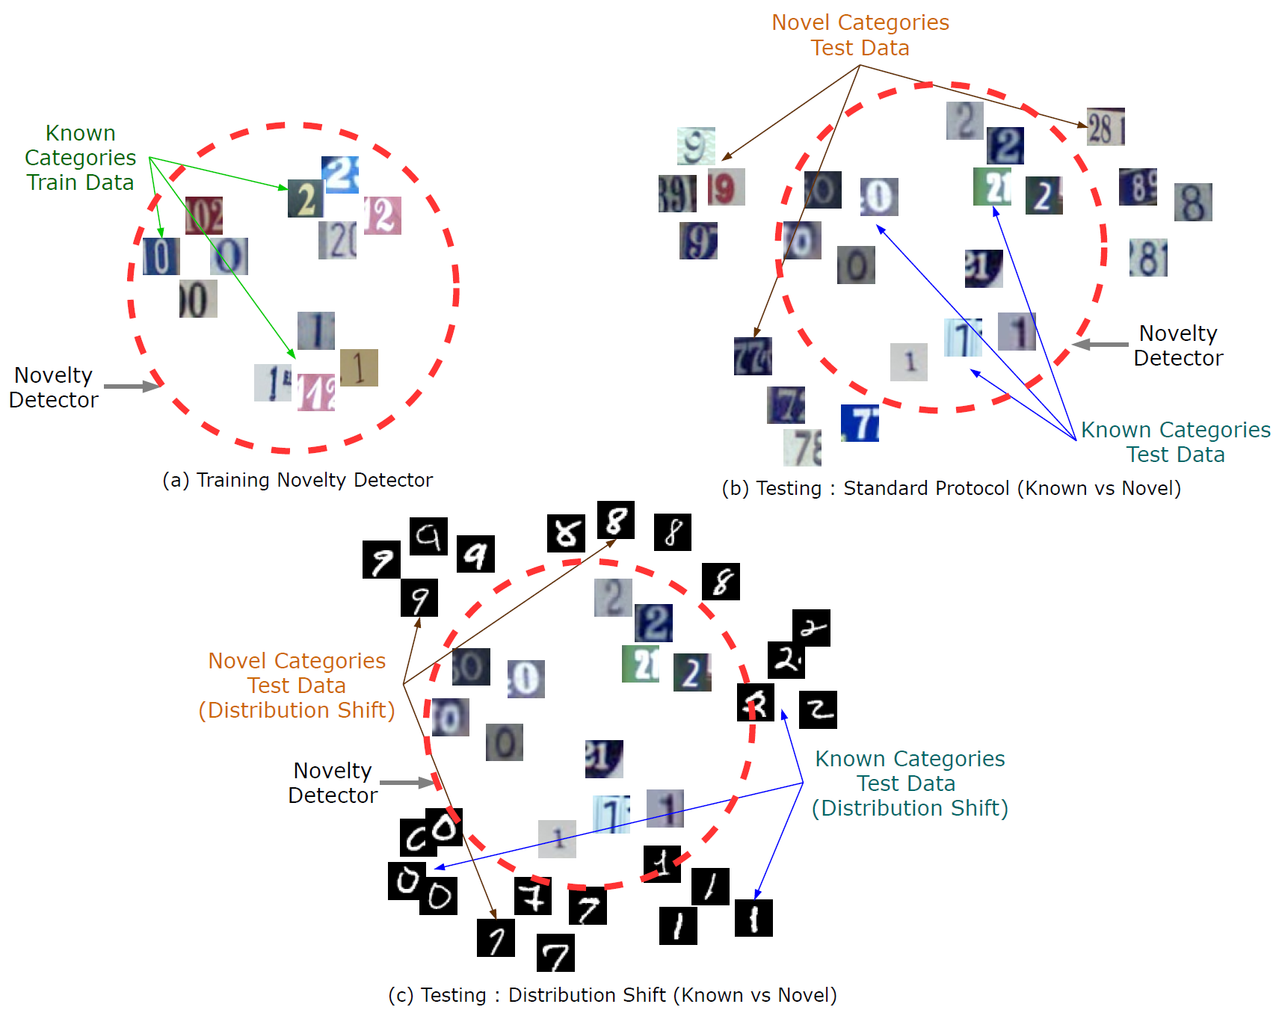
Open class + Out of Distribution (domain)
Maybe more common in application
2020 ECCV Multiple Class Novelty Detection Under Data Distribution Shift

Slide 5
Related Works
Basic
Maximize probability for close sample
Maximize likelihood for close sample
Construct open samples
OOD dataset
GAN to generate open samples
Strong data augmentation
Adversarial samples (Fooling)
The difference between close class and open class
Input perturbation
Reconstruction
Good feature space
Compact feature space for close class

Slide 6
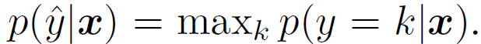

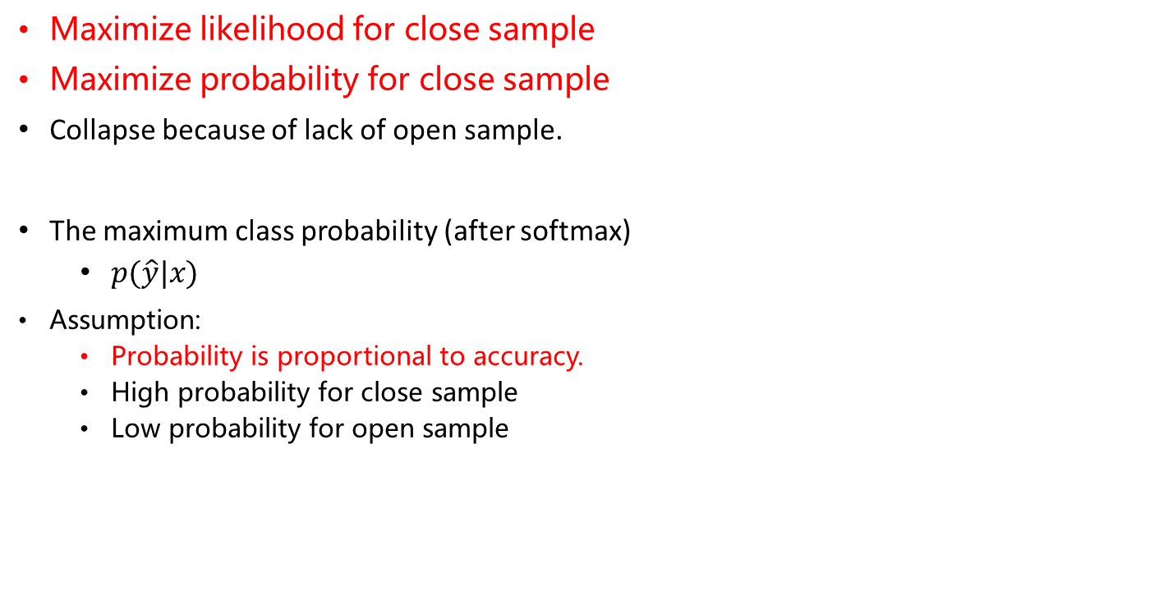
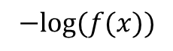
Related works 1: Basic Assumption
$$−log⁡(f(x))$$
Maximize likelihood for close sample
Maximize probability for close sample
Collapse because of lack of open sample.
The maximum class probability (after softmax)
$p(\hat{y}|x)$
Assumption:
Probability is proportional to accuracy.
High probability for close sample
Low probability for open sample
2017 ICLR A Baseline for Detecting Misclassified and Out-of-Distribution Examples in Neural Networks

Slide 7
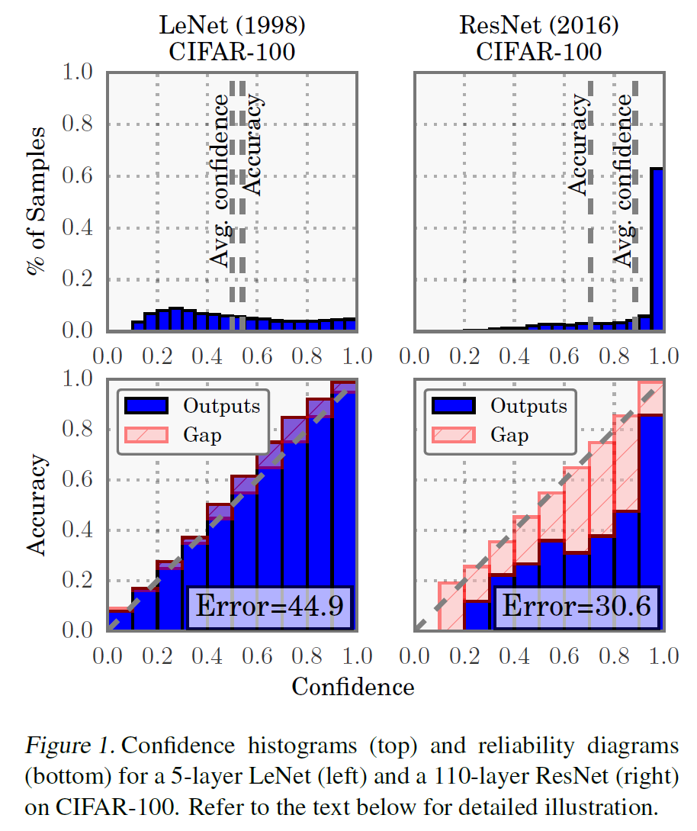
Basic Assumption
The assumption is not always true
High confidence may not mean high accuracy for current models
But we can calibration the model
2017 ICML On Calibration of Modern Neural Networks

Slide 8
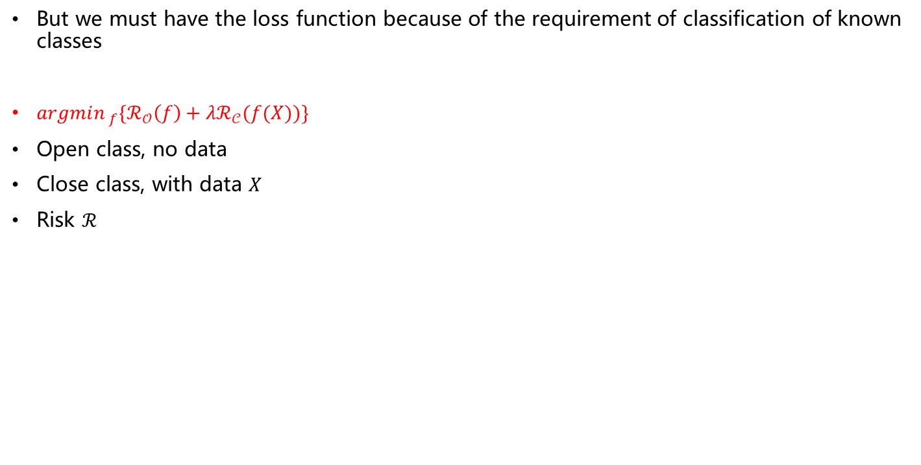
But we must have the loss function because of the requirement of classification of known classes
$argmin_{ f}\{ℛ_{𝒪}\left(f\right)+λℛ_{𝒞}(f(X))\}$
Open class, no data
Close class, with data $X$
Risk $ℛ$
Therefore, a standard baseline for OSR is a model trained with the cross-entropy loss on the known classes.
2013 PAMI Towards open set Recognition

Slide 9
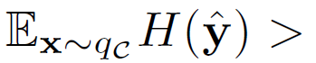
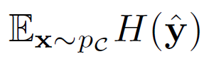
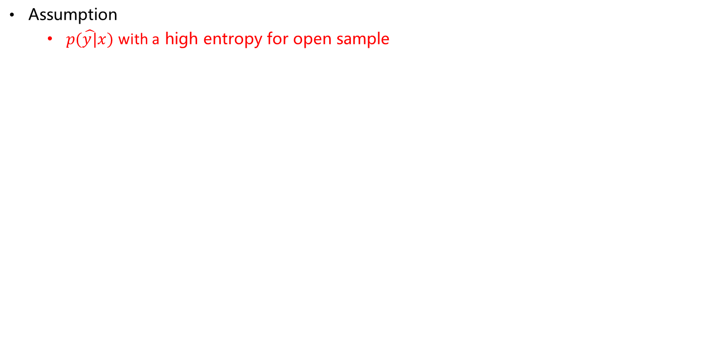
Basic Assumption
Assumption
$p(\hat{y|}x)$ with a high entropy for open sample
2019 CVPR Universal Domain Adaptation

Slide 10
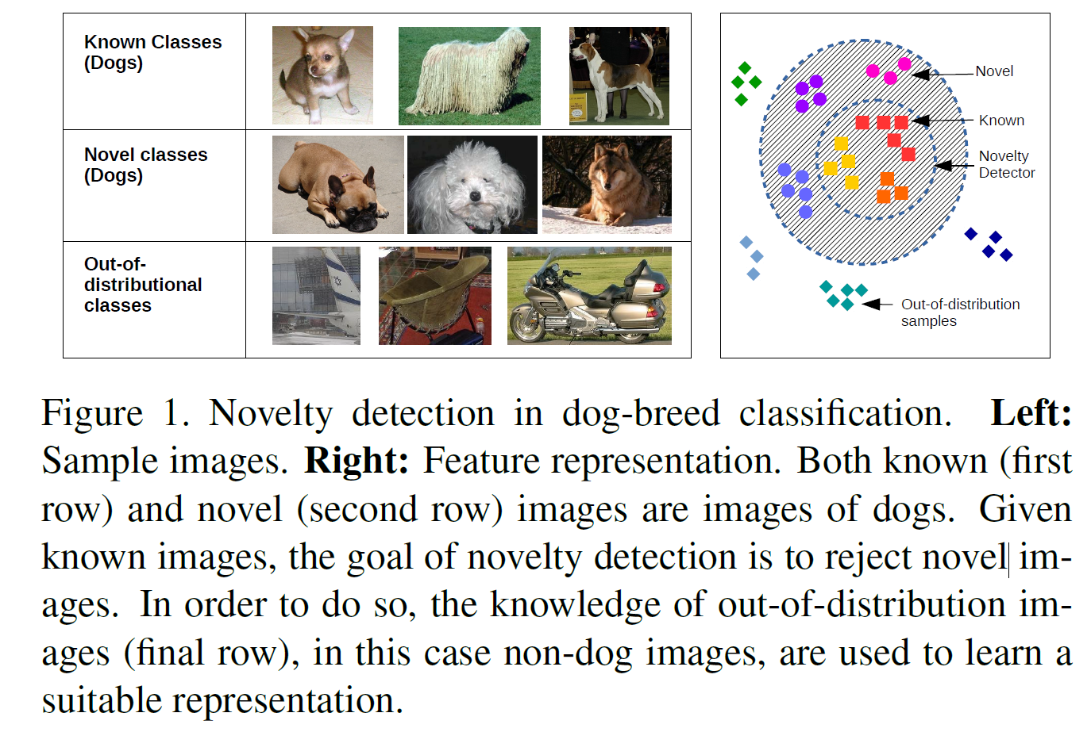
Related work 2: Make Open Samples
OSR: no open sample during training
Using OOD dataset to have a better feature extractor or representation learning
2019 CVPR Deep transfer learning for multiple class novelty detection

Slide 11
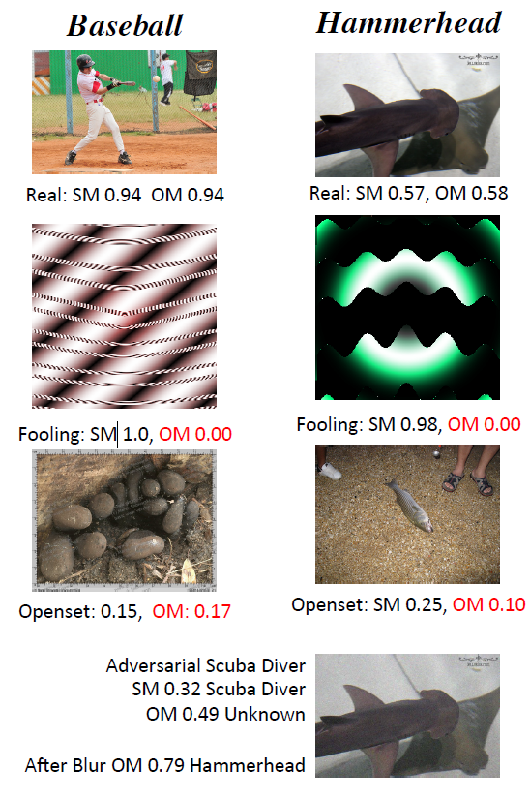
Make Open Samples
OSR: no open sample during training
Using OOD dataset to have a better feature extractor or representation learning
Using GAN generates open sample
Using strong data augmentation
Using adversarial samples
2016 CVPR Towards Open Set Deep Networks

Slide 12
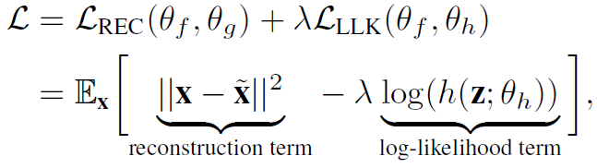
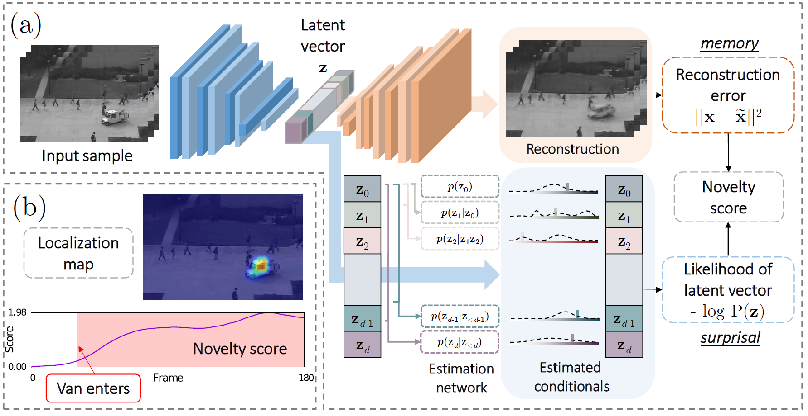
Related work 3: Difference in open and close sample
Assumption:
Reconstruction
2019 CVPR Latent Space Autoregression for Novelty Detection

Slide 13
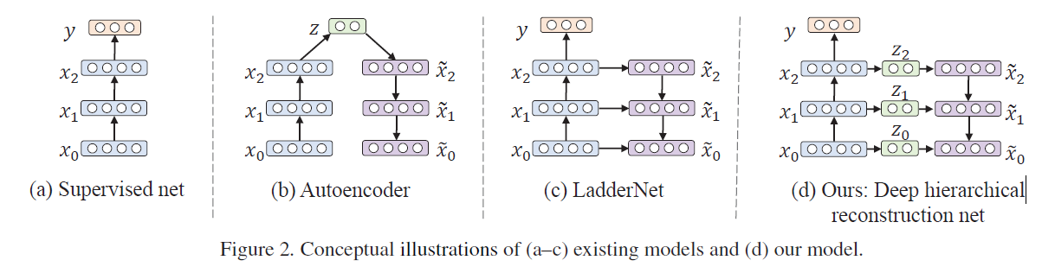
Assumption:
Reconstruction
Very popular
Hierarchical reconstruction
2019 CVPR Classification-Reconstruction Learning for Open-Set Recognition

Slide 14
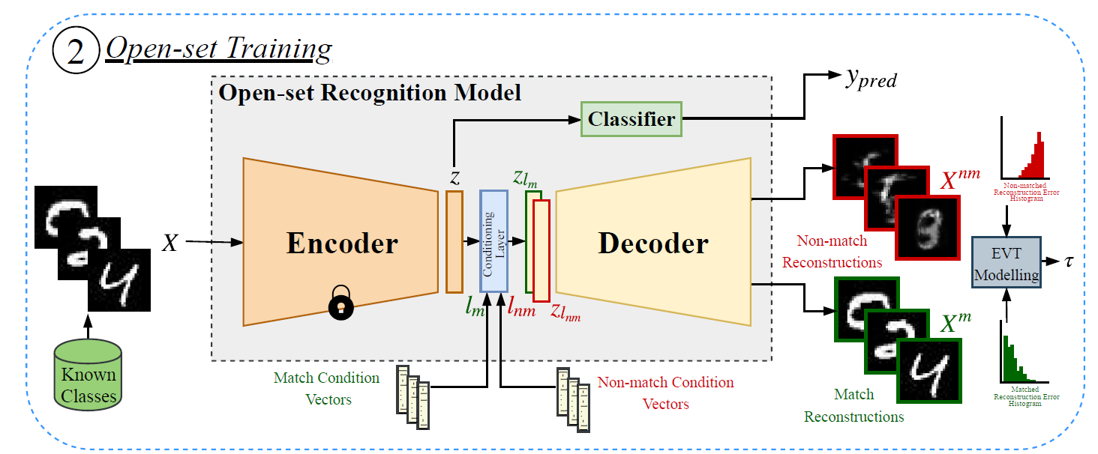
Conditional reconstruction
2019 CVPR Class Conditioned Auto-Encoder for Open-set Recognition

Slide 15
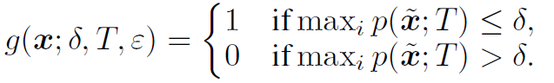
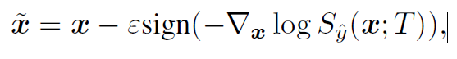
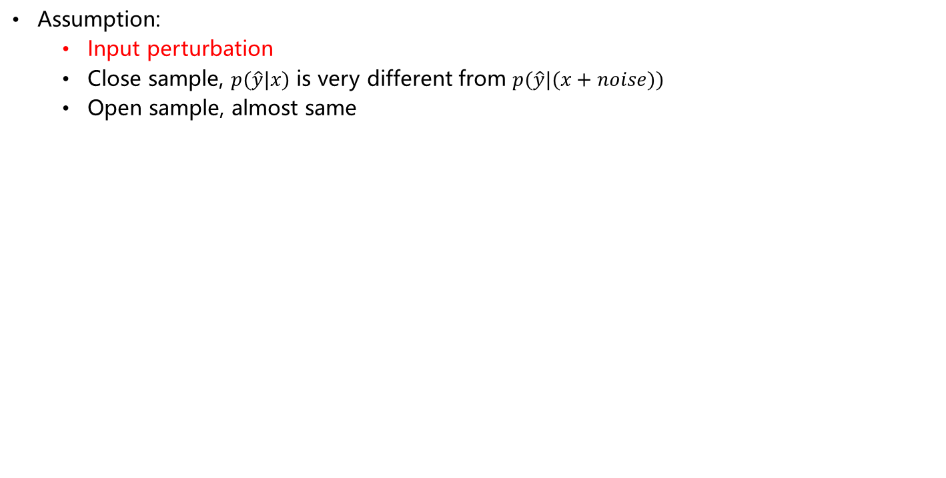
Related work 3: Difference in open and close sample
Assumption:
Input perturbation
Close sample, $p(\hat{y}|x)$ is very different from $p(\hat{y}|(x+noise))$
Open sample, almost same
2018 ICLR enhancing_the_reliability_of_out_of_distribution_image_detection_in_neural_networks

Slide 16
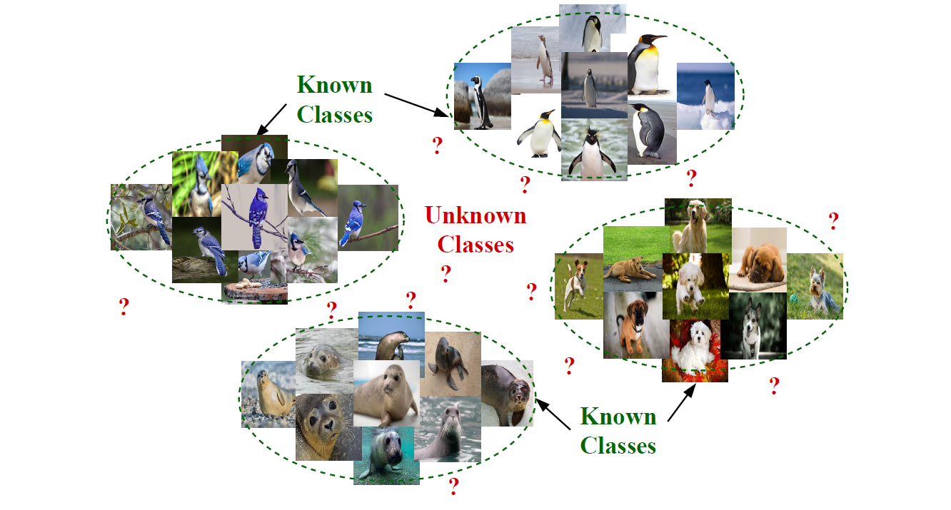
Related work 4: Learn a good feature space for close sample
A desired feature space for close classes
Compact
Similarity within-class is very high
Similarity between-class is very low
2019 CVPR Class Conditioned Auto-Encoder for Open-set Recognition

Slide 17
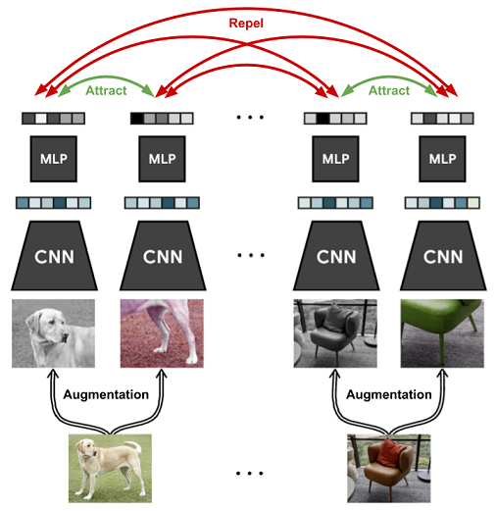
SVM, one-vs-all SVM
Contrast learning
Strong data augmentation to generate negative sample
Classifier to predict the type of data augmentation
2020 NIPS CSI Novelty Detection via Contrastive Learning on Distributionally Shifted Instances
2020 ICML A simple framework for contrastive learning of visual representations

Slide 18
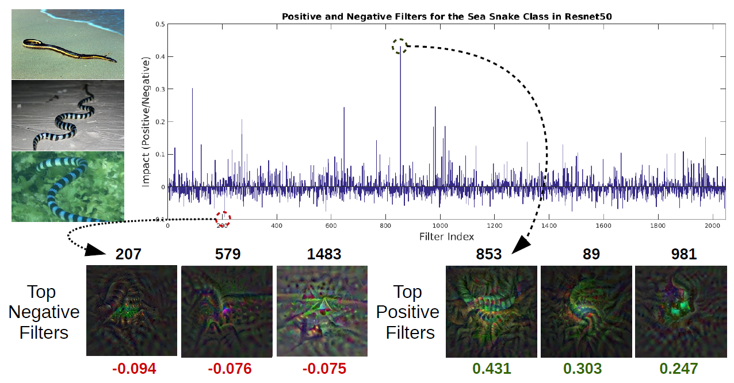
Negative and positive filter for each class
Global negative filter for all known classes
2019 CVPR Deep transfer learning for multiple class novelty detection

Slide 19
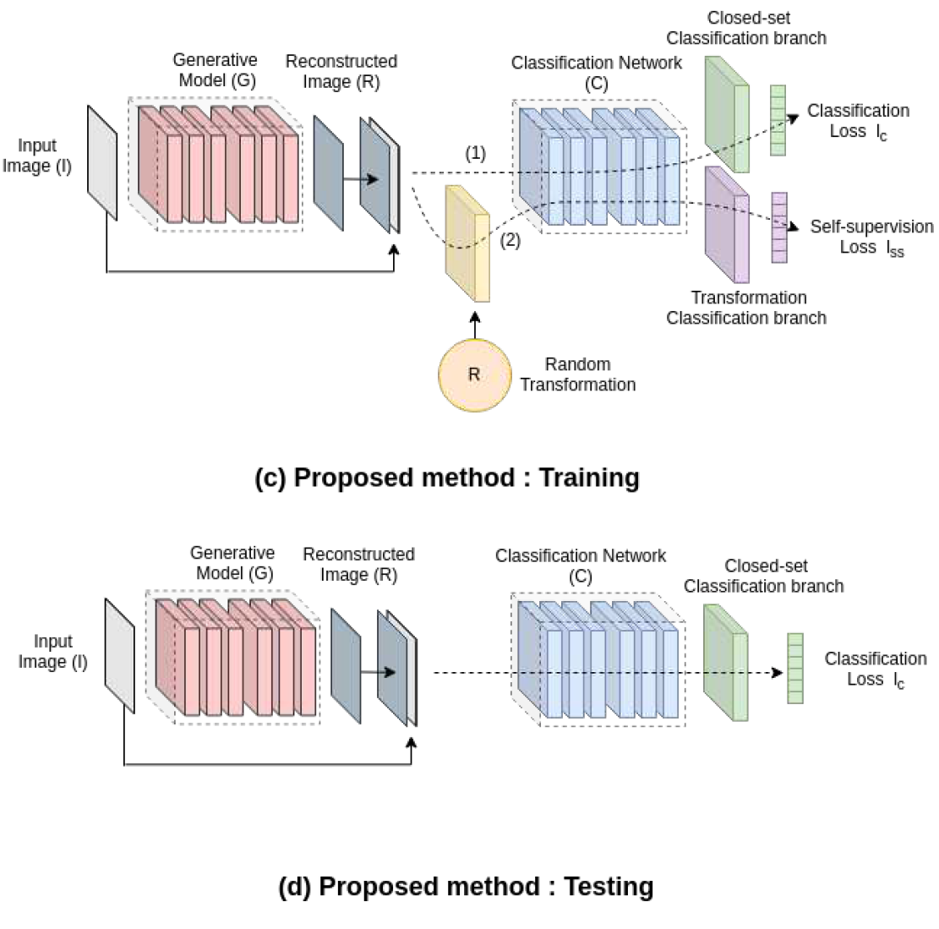
SSL
2020 CVPR Generative-discriminative feature representations for open-set recognition

Slide 20
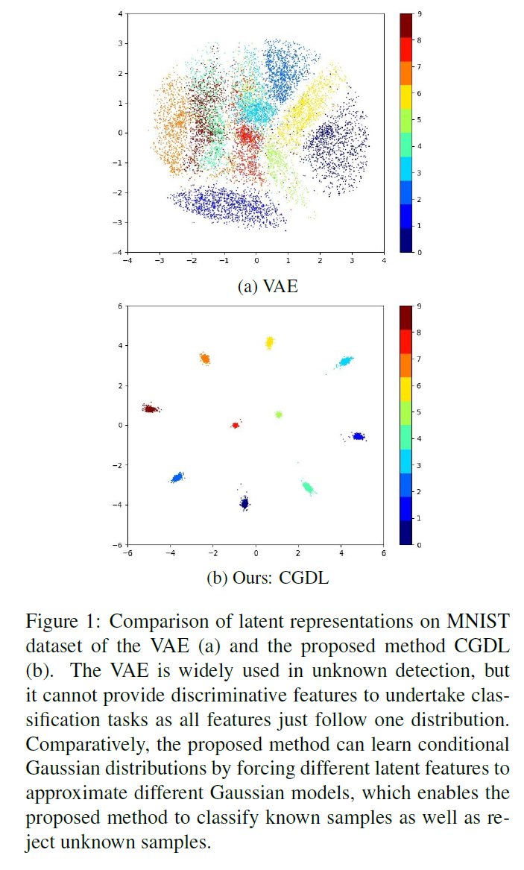
Prototype for each class
2020 CVPR Conditional gaussian distribution learning for open set recognition

Slide 21
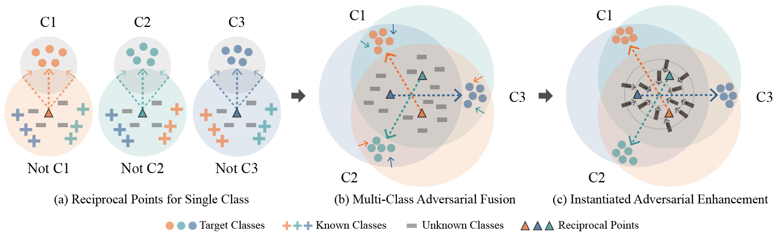
Reciprocal point for each class
SOTA 1: ARPL + CS
2021 PAMI Adversarial reciprocal points learning for open set recognition
2020 ECCV Learning open set network with discriminative reciprocal points

Slide 22
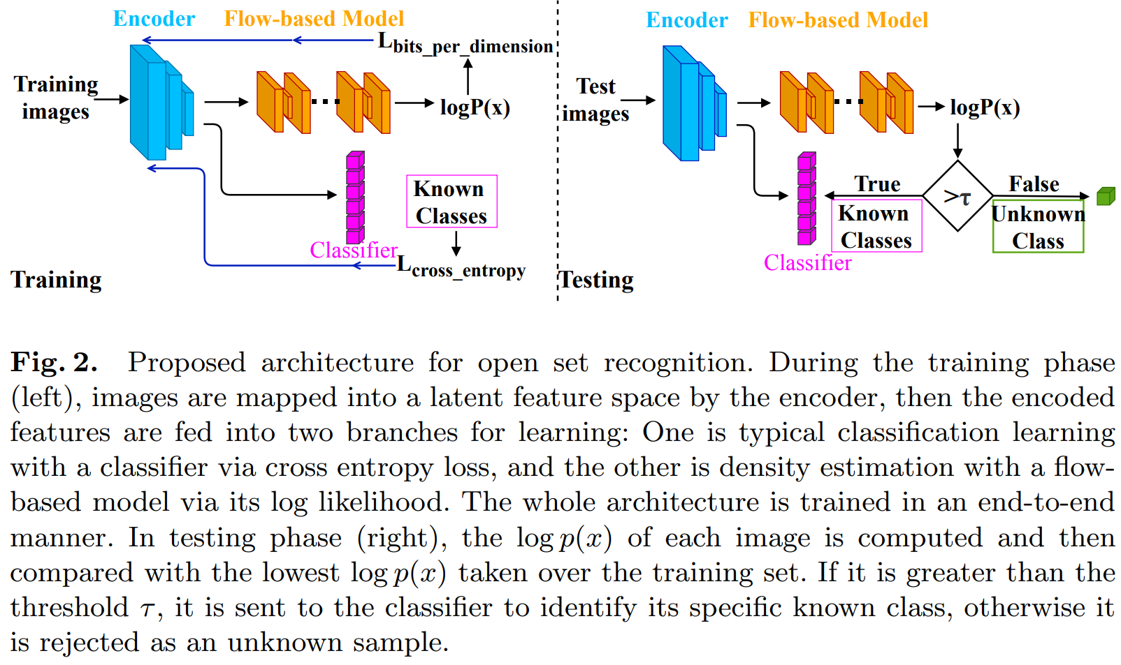
SOTA 2
2020 ECCV Hybrid models for open set recognition

Slide 23
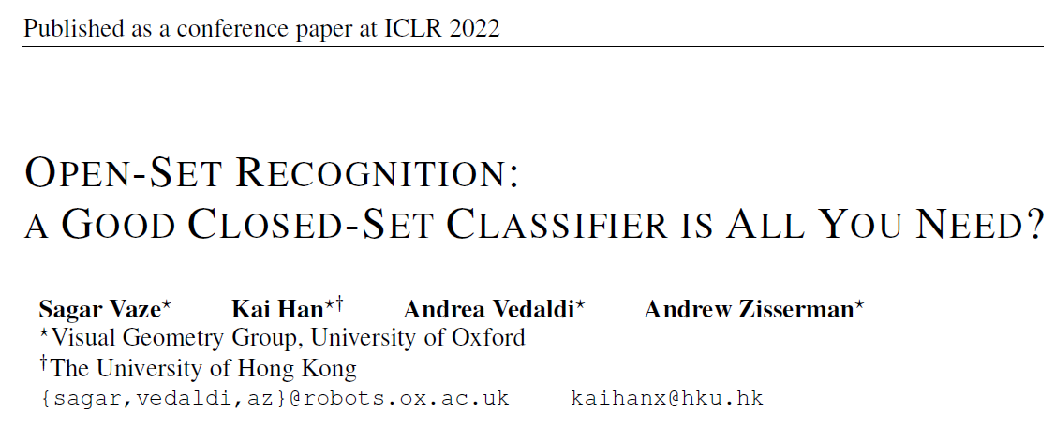

Slide 24
Formulation of OSR
Baseline: maximum softmax probability (MSP)

Slide 25
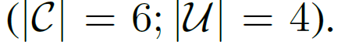
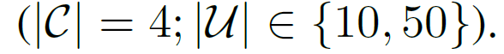
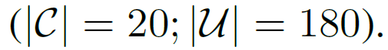
Datasets: MNIST, SVHN, CIFAR10
CIFAR + N
CIFAR10 + CIFAR100
TinyImageNet (200 classes in total)

Slide 26
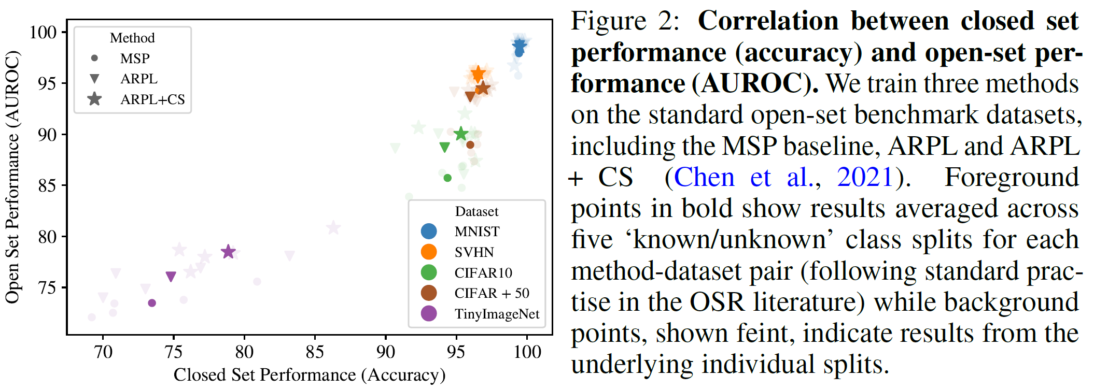
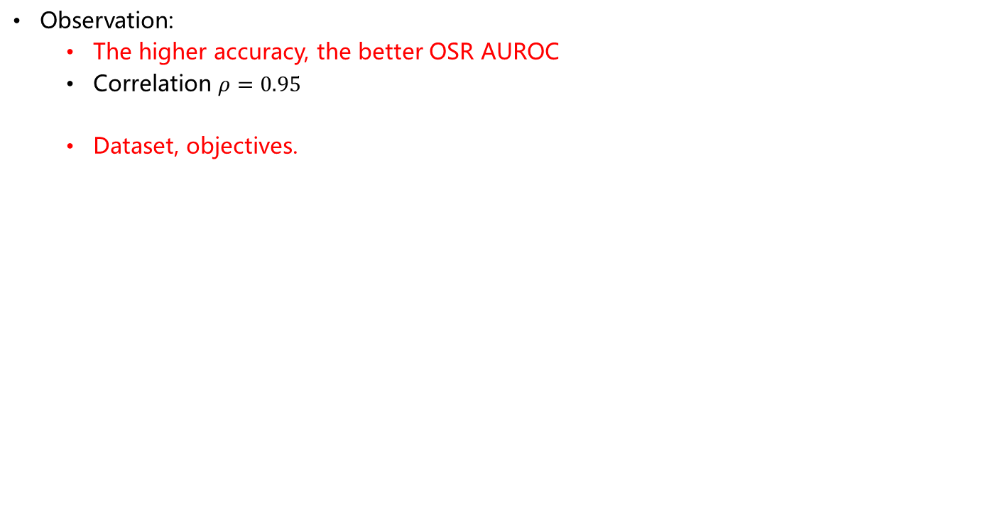
Observation:
The higher accuracy, the better OSR AUROC
Correlation $ρ=0.95$
Dataset, objectives.

Slide 27
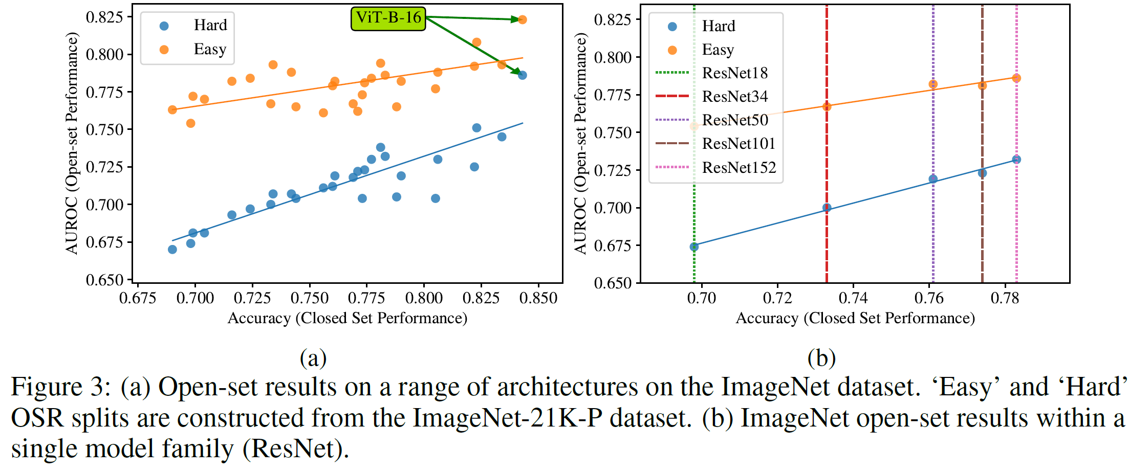
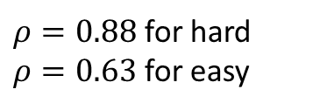
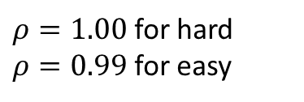
Same relation in large scale dataset
Model architectures.
$ρ=0.88$ for hard
$ρ=0.63$ for easy
$ρ=1.00$ for hard
$ρ=0.99$ for easy

Slide 28
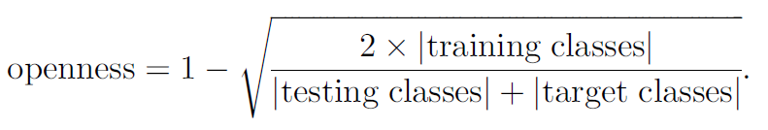
How to measure the difficulty of OSR?
Openness: number of classes, number of images in each class
2013 PAMI Towards open set Recognition: openness

Slide 29
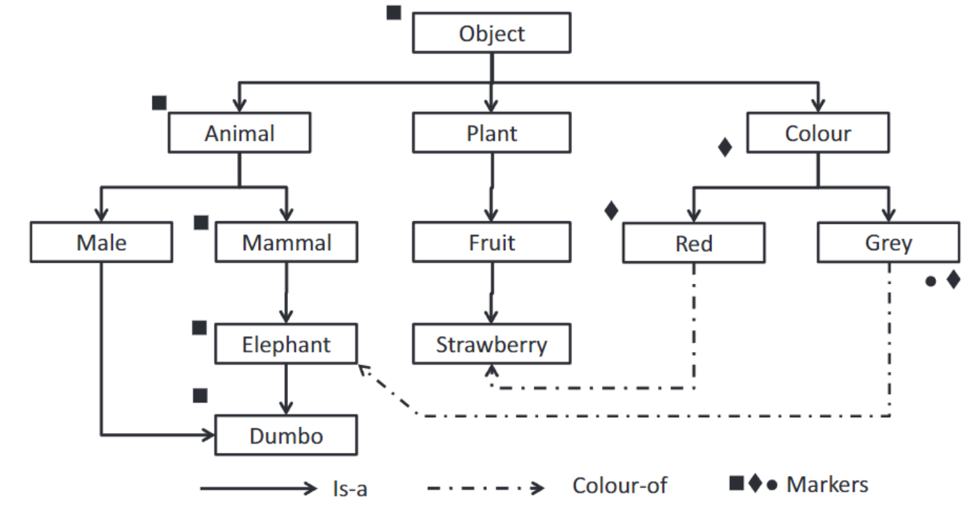
Semantic novelty: based on semantic tree
Semantic distance between two class it the total path distance between nodes in the semantic tree
Between two datasets (all open and closed classes): summation of all classes
My idea: FID?
Picture from Barba, Jesús, et al. "FPGA acceleration of semantic tree reasoning algorithms." Journal of Systems Architecture 61.3-4 (2015): 185-196.

Slide 30
The closed-set and open-set performance are highly correlated across datasets, objectives and model architectures.

Slide 31
Observation → Action
The open-set performance can be improved by enhancing its closed-set accuracy, longer training, data augmentation, learning rate schedule, label smoothing, …
Why?
Model calibration: probability is calibrated
Compact feature space.

Slide 32
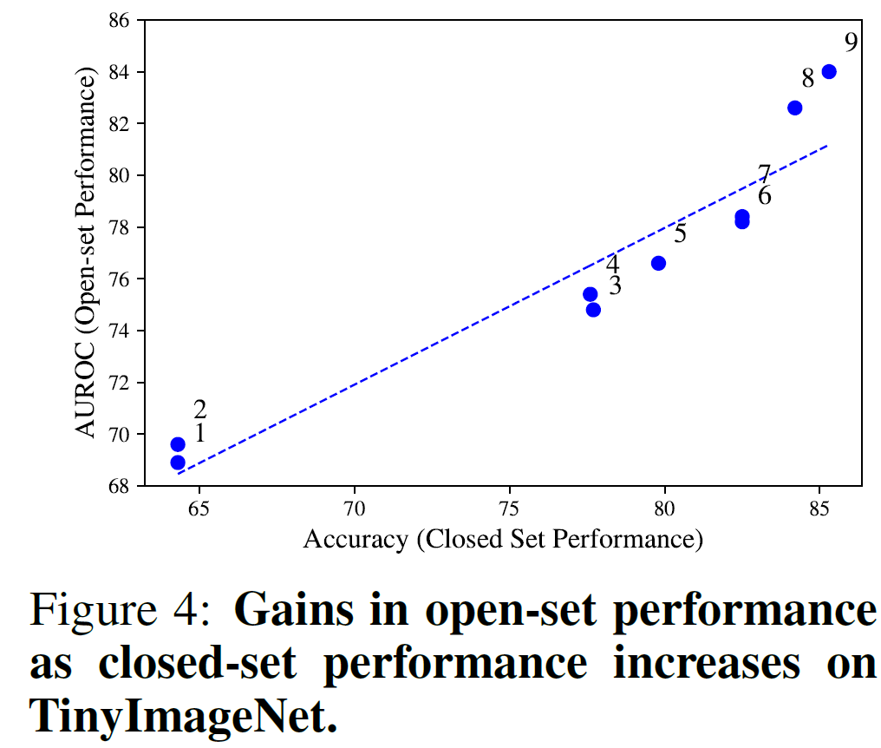
Based on MSP (maximum softmax probability)
Longer training (7-8)
Better augmentation (3-5)
Label smoothing
Ensemble (8-9)
Logit scoring rule
MLS (maximum logit score)

Slide 33
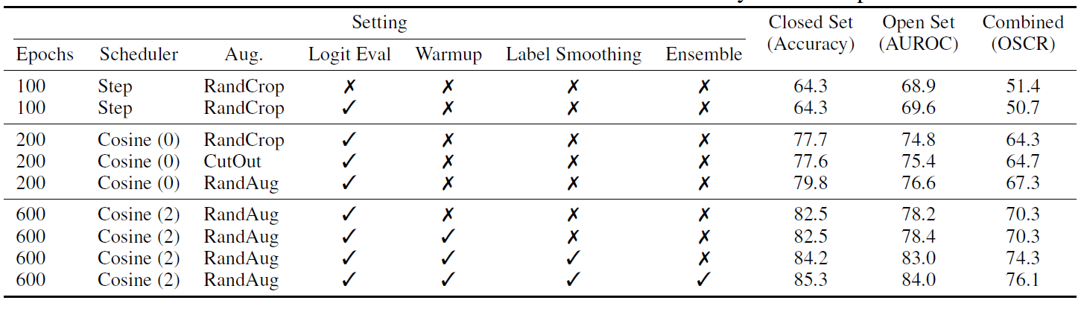

Slide 34
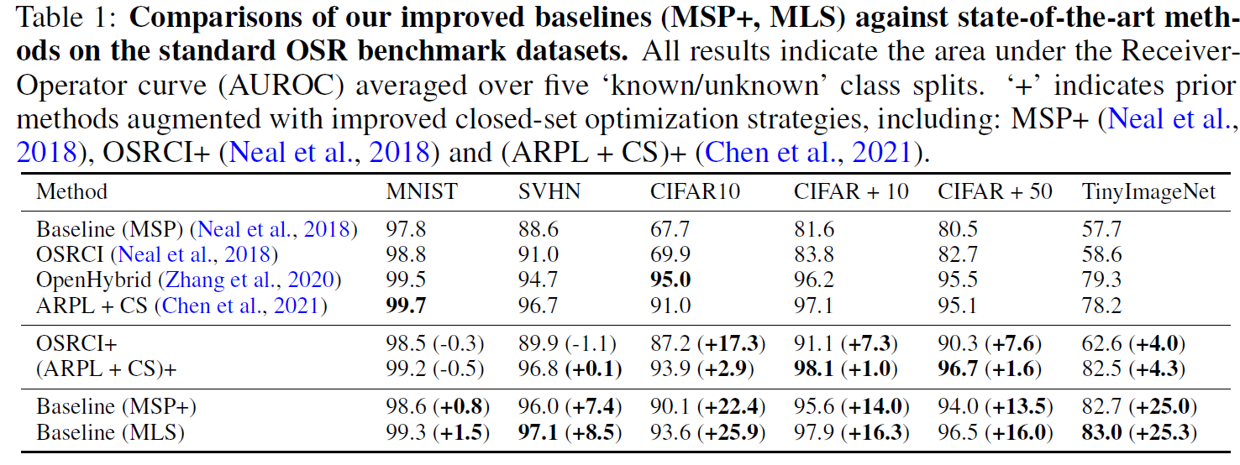

Slide 35
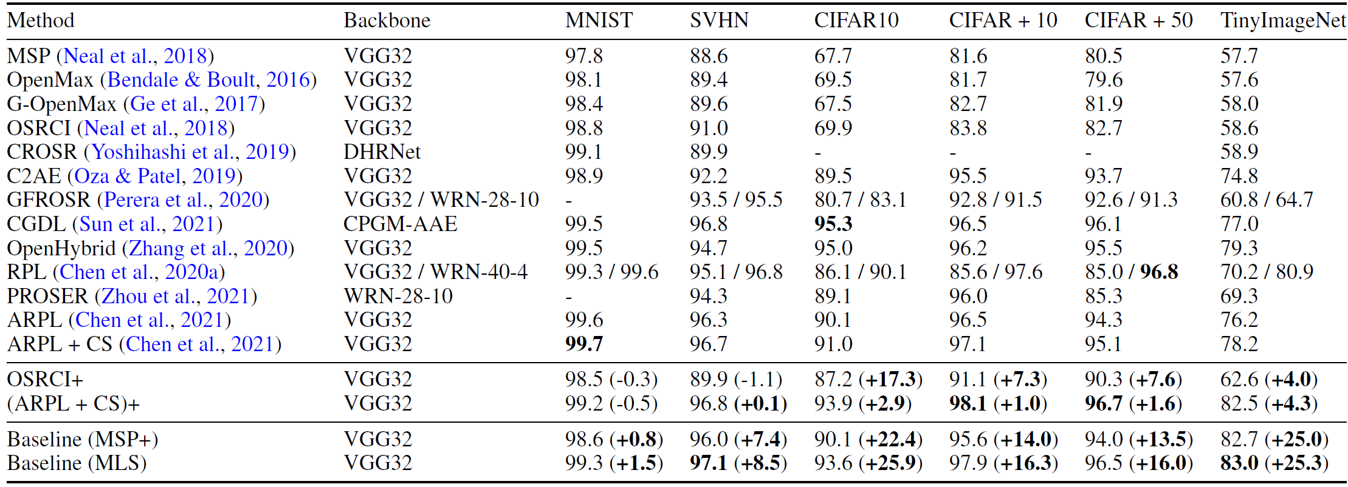
Amazing: MLS and MSP+ are better

Slide 36
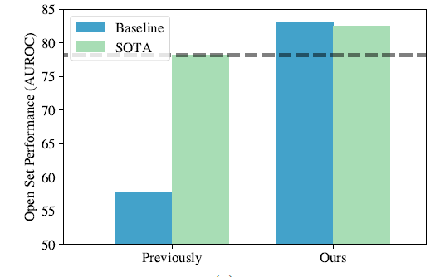

Slide 37
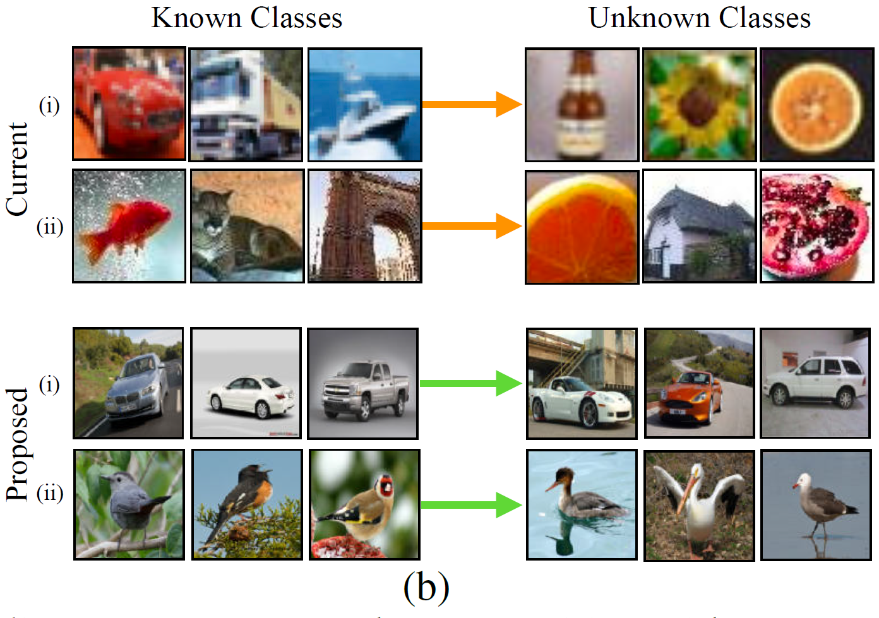
Novel Dataset

Slide 38
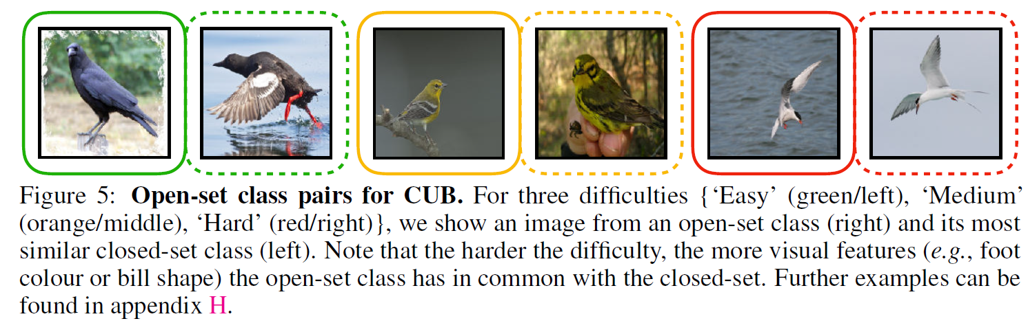
Novel dataset for OSR
The drawbacks of current dataset for OSR:
Small scale
No clear definition of open class.
Semantic novelty
Path length in the semantic tree
CIFAR10
Closed class {airplane, automobile, ship, truck}
Open class {bicycle, bee, porcupine, baby}
FGVC (fine-grained visual classification)
Bird species.
Attributes.
The variation is more specific.

Slide 39
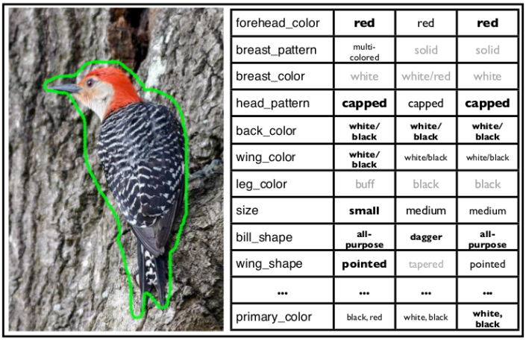
CUB datasets for birds with attributes

Slide 40
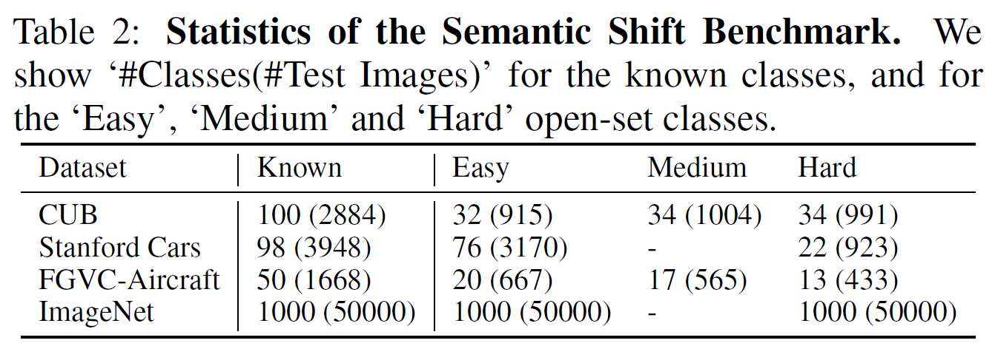

Slide 41
Plant disease open set should be categorized as Fine-grained open set recognition
FG-OSR
Semantic vs Texture

